Slide 1
Lecture 19
Nick Rugai PhD

Slide 2


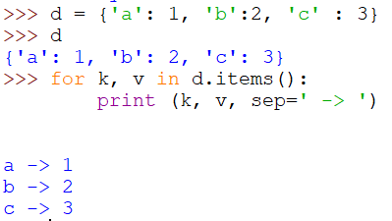
Arguments to print()
Keyword arguments allow added features to the print function.
sep=<str>, allows objects to be separated

Slide 3
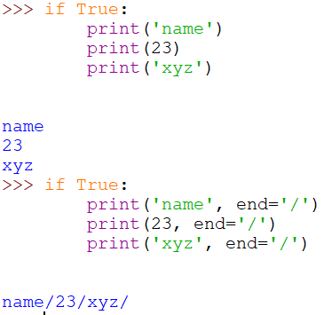
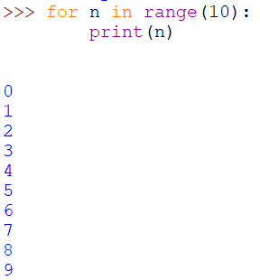
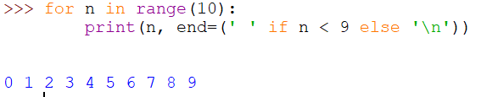
Arguments to print()
The keyword argument end=<str> causes output to be terminated by <str> instead of the default newline:

Slide 4

Arguments to print()
We have seen the modulo operator before %
When it comes to strings, it has a totally different meaning:
String formatting
%d represents an integer
%s represents a string
%.2f represents a float
They also work for assigning strings to variables:

Slide 5
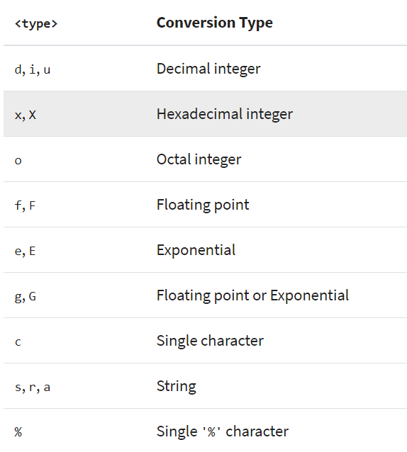
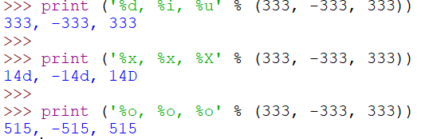
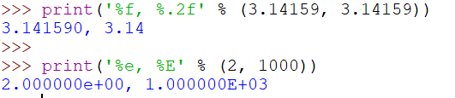

Arguments to print()

Slide 6




Arguments to print()
Width and Precision control:
The flag # adds the base information:

Slide 7
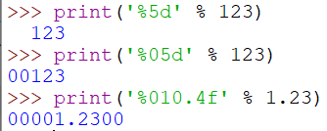
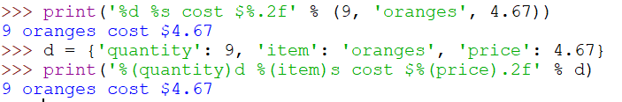
Arguments to print()
The flag 0 adds 0 padding:
Dictionary Mapping:

